Slide 1
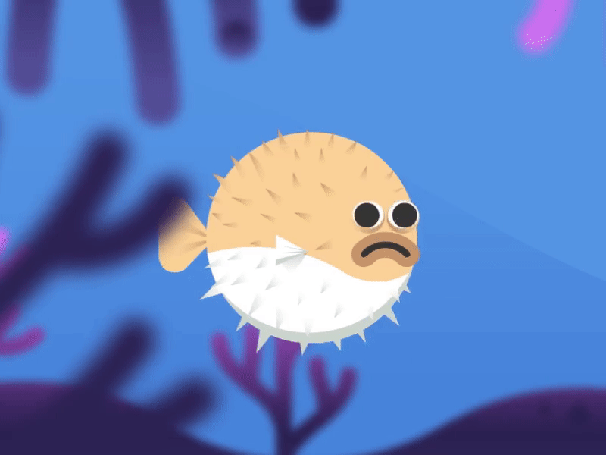
Puffy Fish
Coding Cobbers
Matthew, Huy, Kai, and Ben

Slide 2

Main Menu
Puffy Fish
1
2
Play Button - Any action on the button would take you right into the game
Shop- Get rewarded for playing, or spend money to buy cool features to add to your character
Settings- Include sfx, music, notifications, ect.
3
Play
Shop
4
Settings
5

Slide 3
Playthrough
Has things such as fish, fishing line, or sea plants blocking your way

Slide 4
Settings
SETTINGS
6
SFX
SFX- Sound effects, can toggle between on and off
Music- Can toggle between on and off
7
MUSIC
8
NOTIFICATIONS
Abcdef….
Abcxyz
Something…

Slide 5

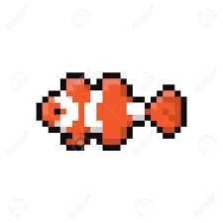

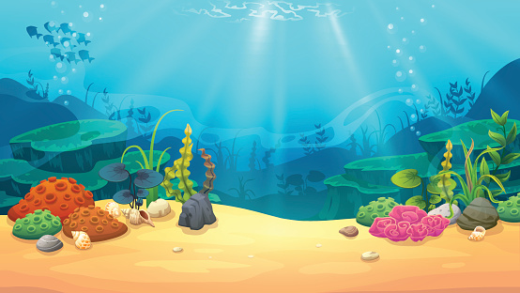
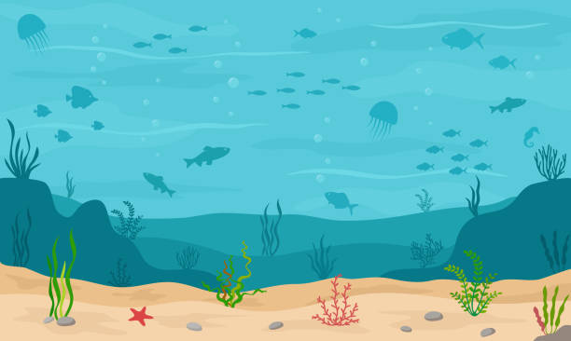
Shop
SHOP
Skins
9
10
11
Skins & Backgrounds - Can buy with credits you earn from getting higher scores
Credits- Can obtain by earning them as you play
Backgrounds
12
13

Slide 6

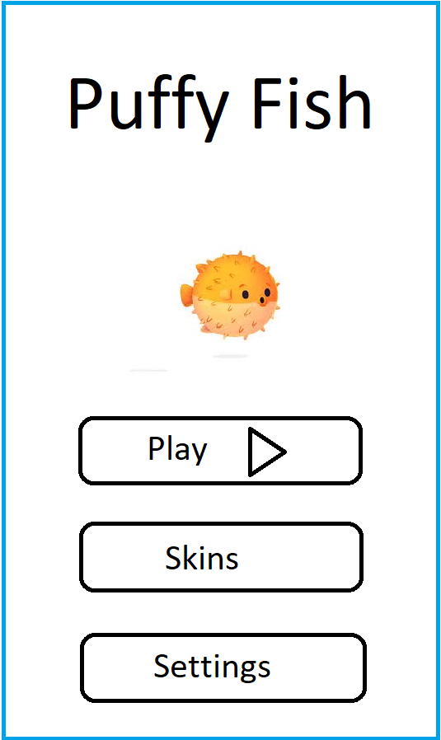
Things that have gone well
Created more than just a few models of mock ups
Ideas for things such as different skins, a shop to customize
Working together as a group

Slide 7

Challenges faced
Where to actually start on the code, ideas for the game
Have looked online for inspiration
Graphics in the mock ups
Programs such as photoshop, pixel editor would help significantly
Group communication
4 members to 2 members

Slide 8

Our plan for the remaining work
Specifically focus on writing the code for next milestone
Making graphics better for the game
Get help from tutors, and teachers
Meeting more often as a group

